Slide 1

What is Callable

Slide 2
Reference
Steven Lott’s Blog and Youtube
Youtube
Code

Slide 3
A callable is an object which can call data and do something with it like a function do.

Slide 4
Callable
Function
Lambda
Higher-order function
Class
Method
Instance constructed by class with call method
And more

Slide 5
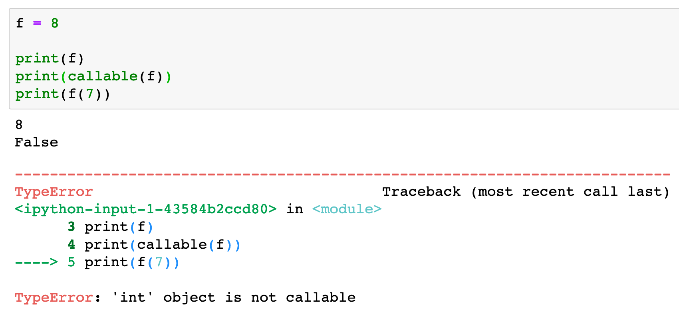

Slide 6
Function

Slide 7
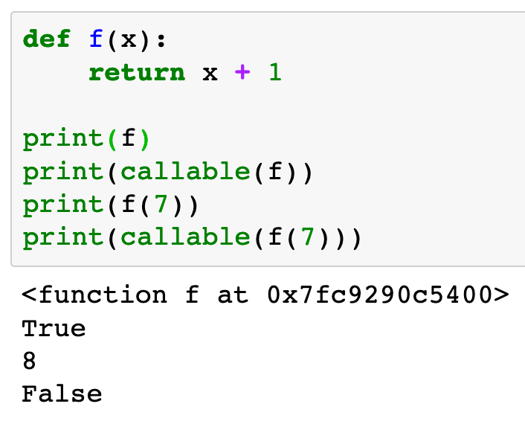

Slide 8
Lambda

Slide 9
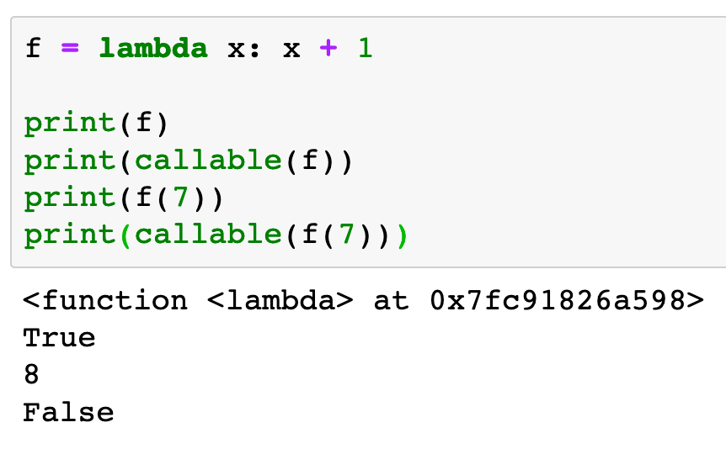

Slide 10
Higher-order function

Slide 11
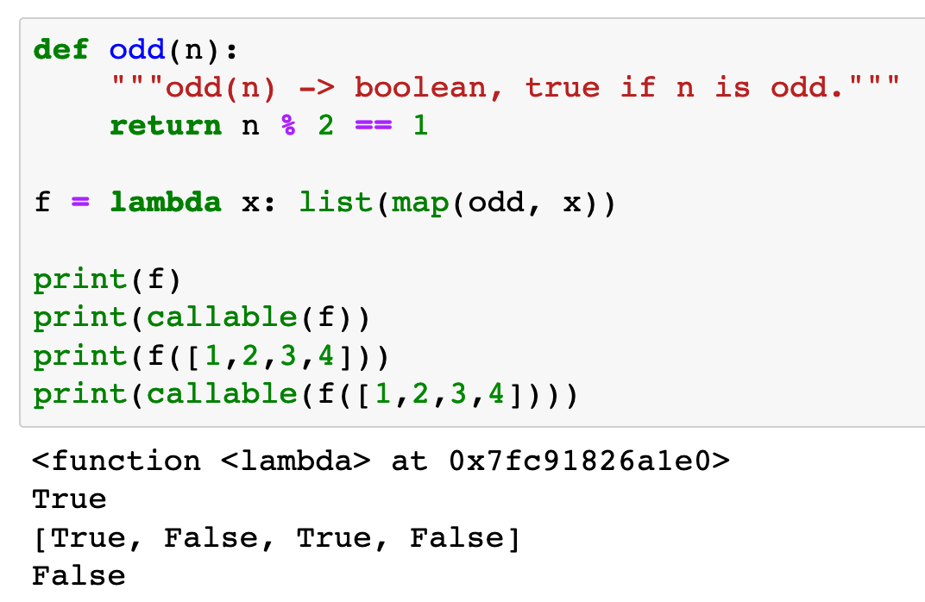

Slide 12
Class

Slide 13
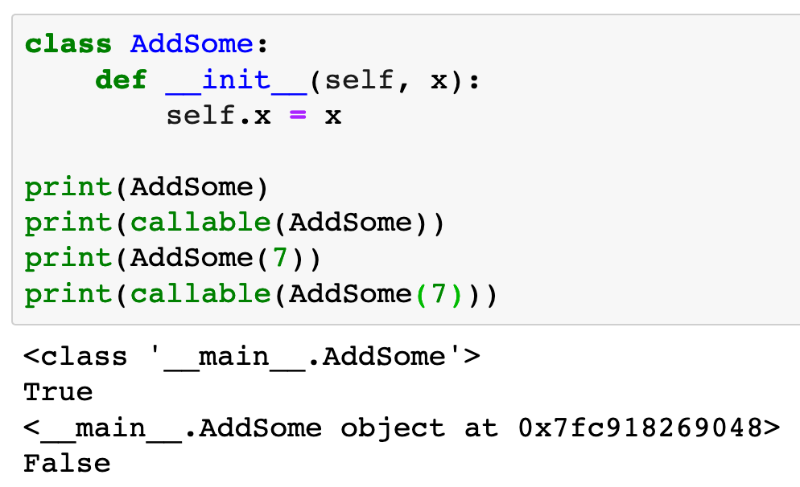

Slide 14
Method

Slide 15
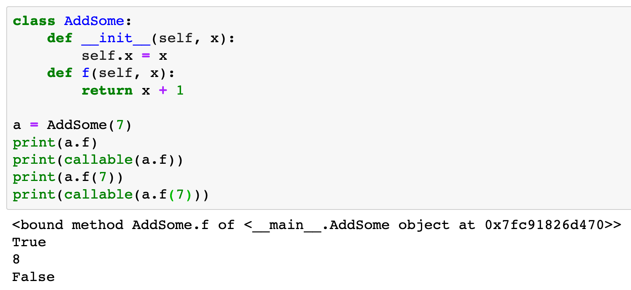

Slide 16
Instance constructed by class with call method

Slide 17
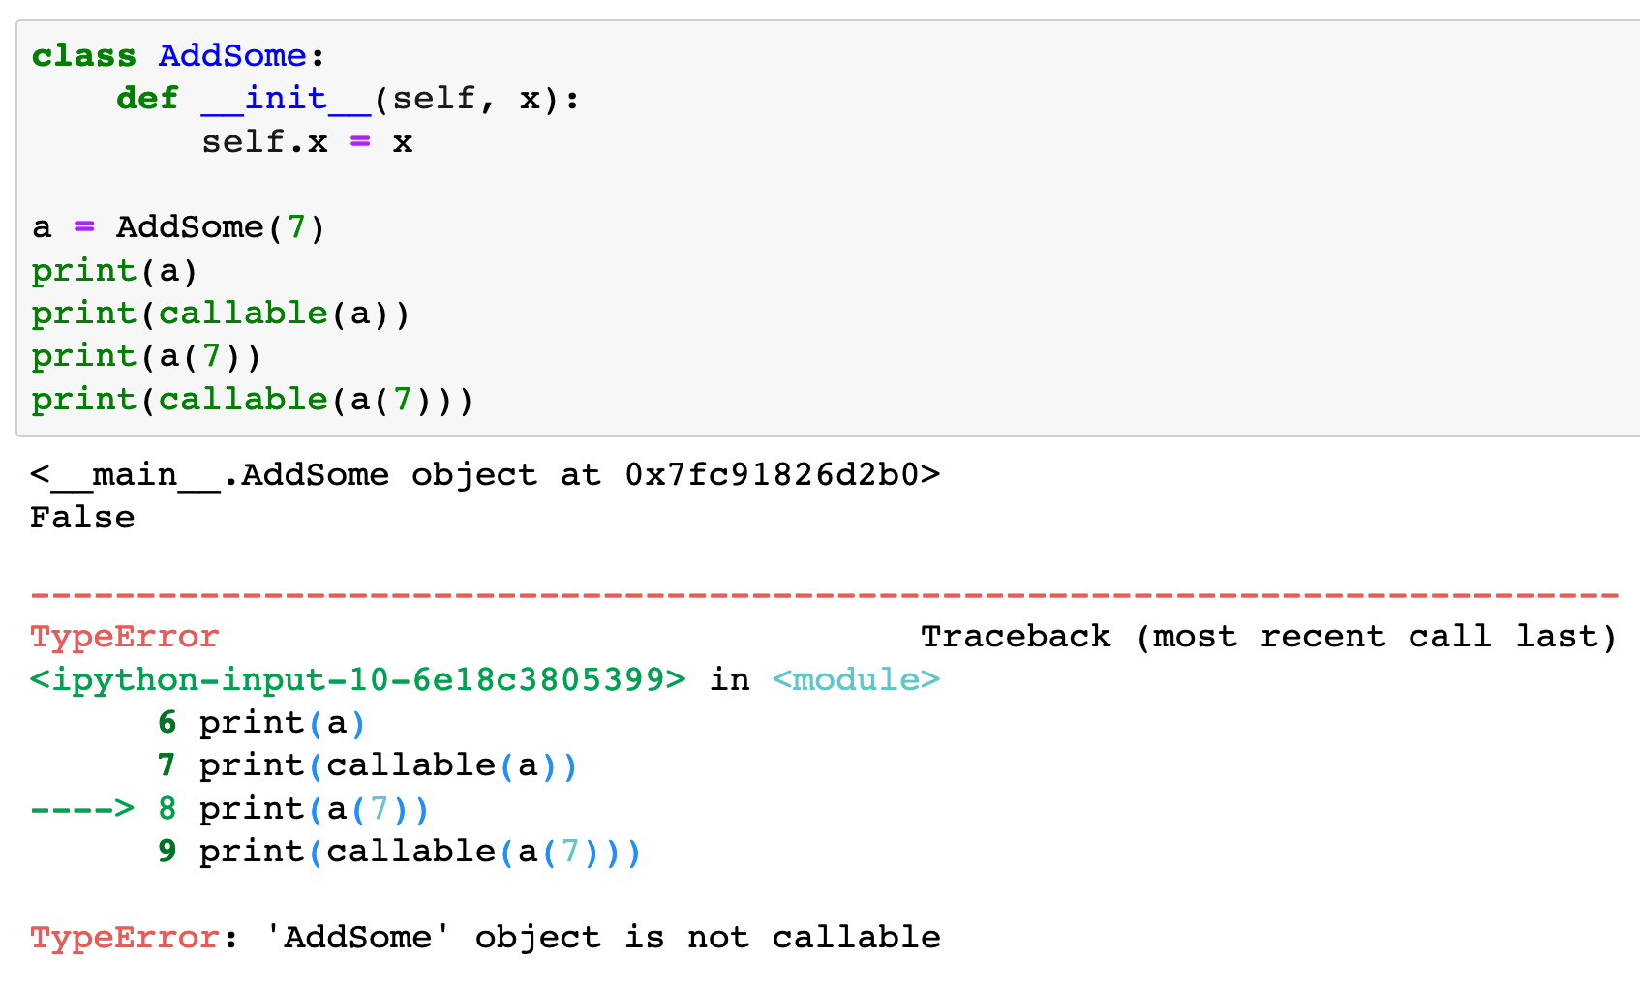

Slide 18
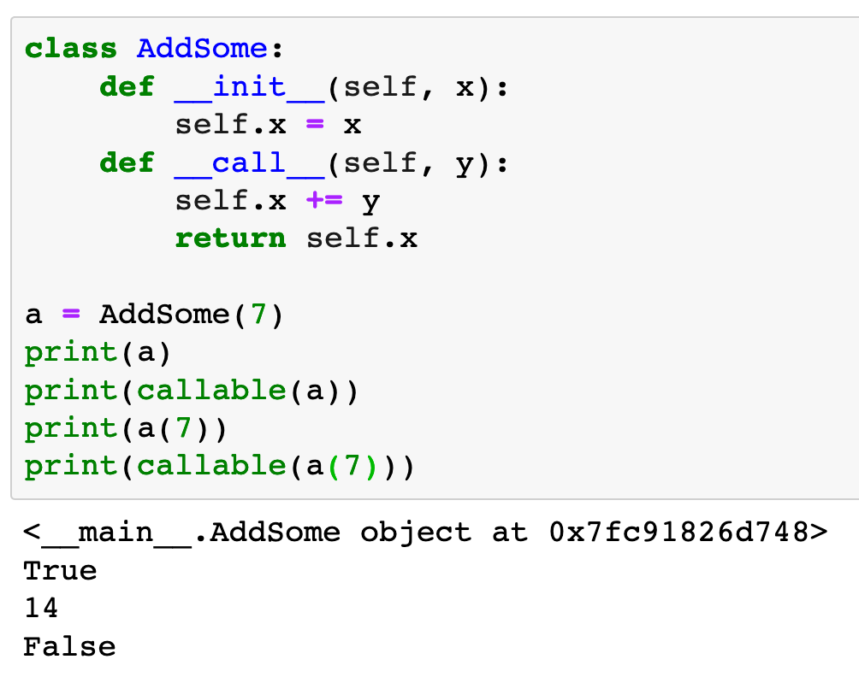

Slide 19
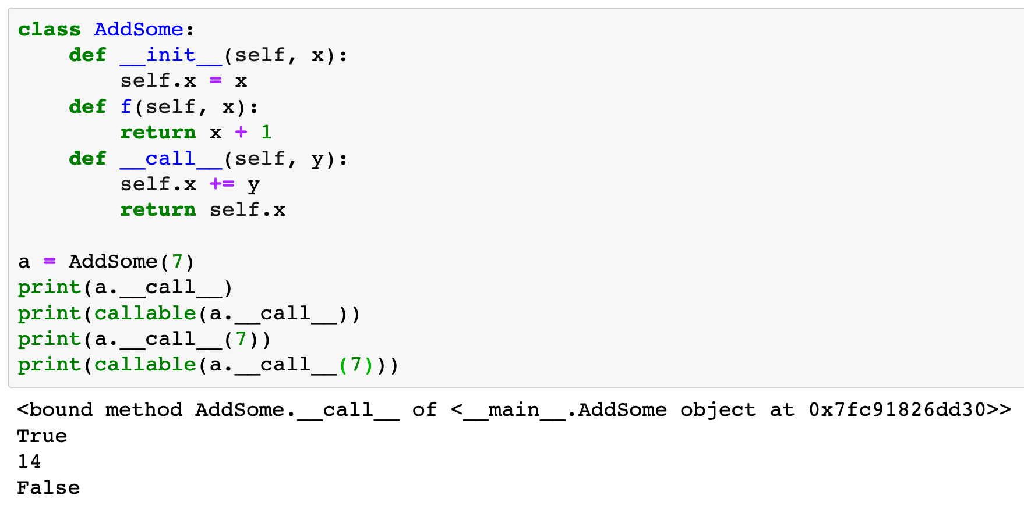

Slide 20
Now
Let’s Play with Code

